Slide 1
Advanced pharmaceutical analysis Lect. 2

Slide 2
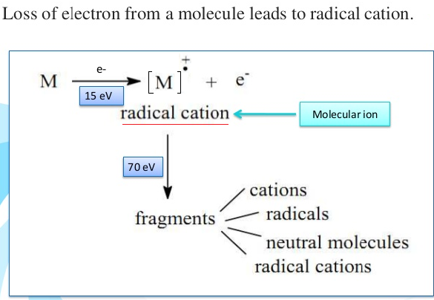

Slide 3
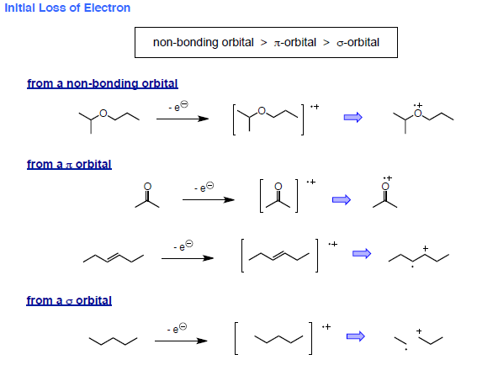

Slide 4
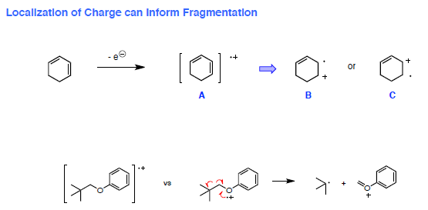

Slide 5
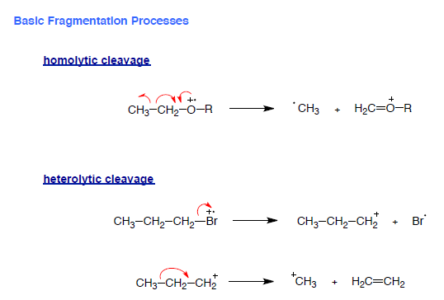
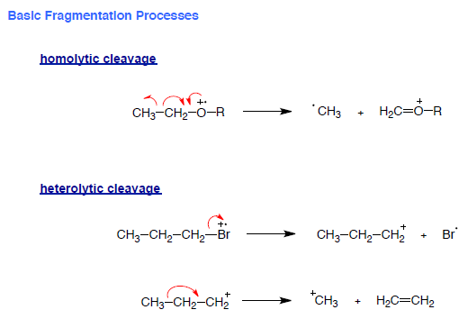

Slide 6
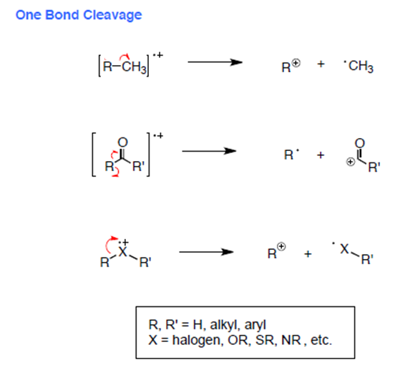

Slide 7
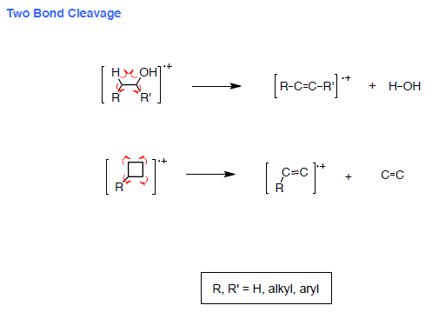

Slide 8
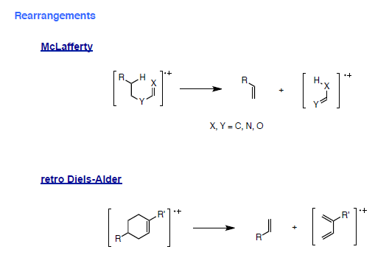

Slide 10
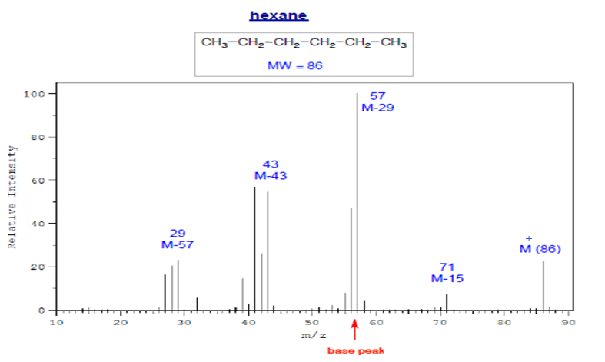
Alkanes Straight Chain Alkanes [R-Rˉ ]→ R⁺ + ͘͘Rˉ [M⁺]= weak * preference small R⁺ C3H7⁺, C4H8⁺ ,C5H11⁺ • A peak for M-CH3 is often weak or absent

Slide 11
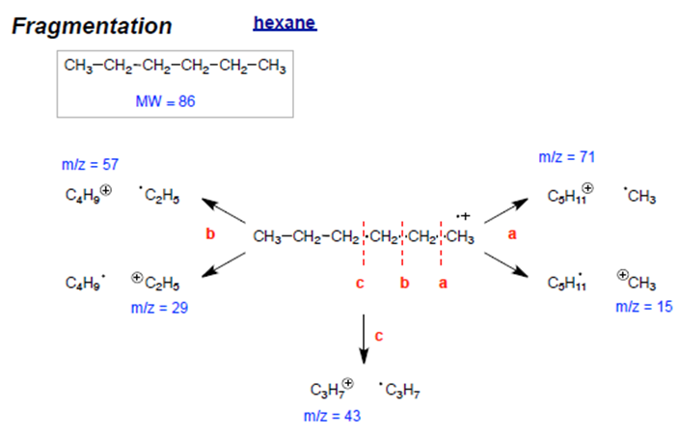

Slide 12
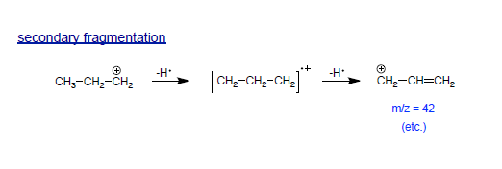

Slide 13
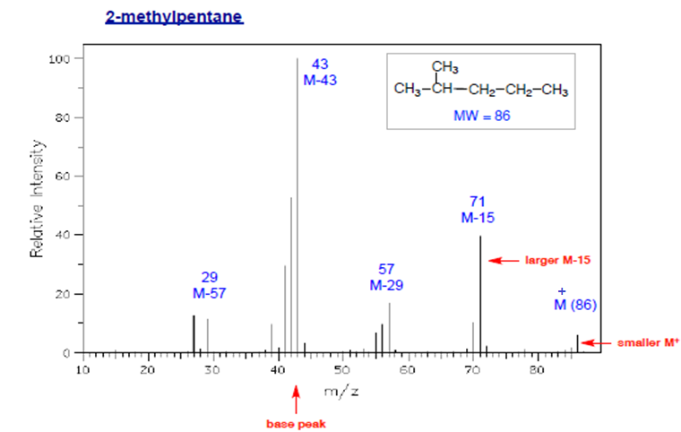
Branched Alkanes • Smaller M⁺ peak; may be absent • More fragmentation at highly branched positions * preference for 2 ͦ, 3 ͦcarbocation

Slide 14
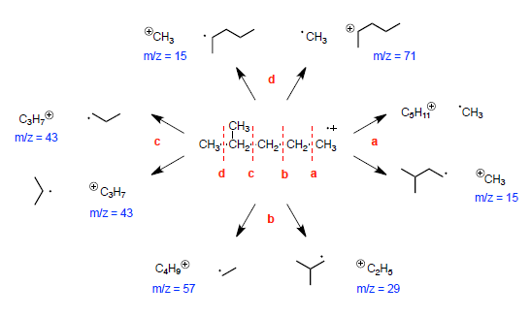

Slide 15
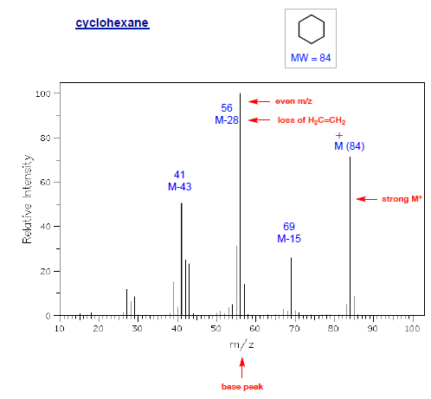
Cycloalkanes • Relatively large M⁺ peak • Significant peak at M-28 (often the base peak) due to loss of ethylene • M-15: from rearrangement

Slide 16
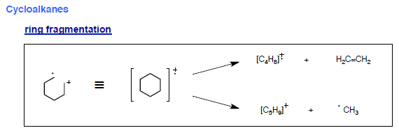
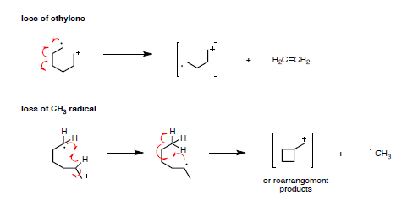

Slide 17
